Slide 1
Micro-Robotics Lab
Weekly Update

Slide 2
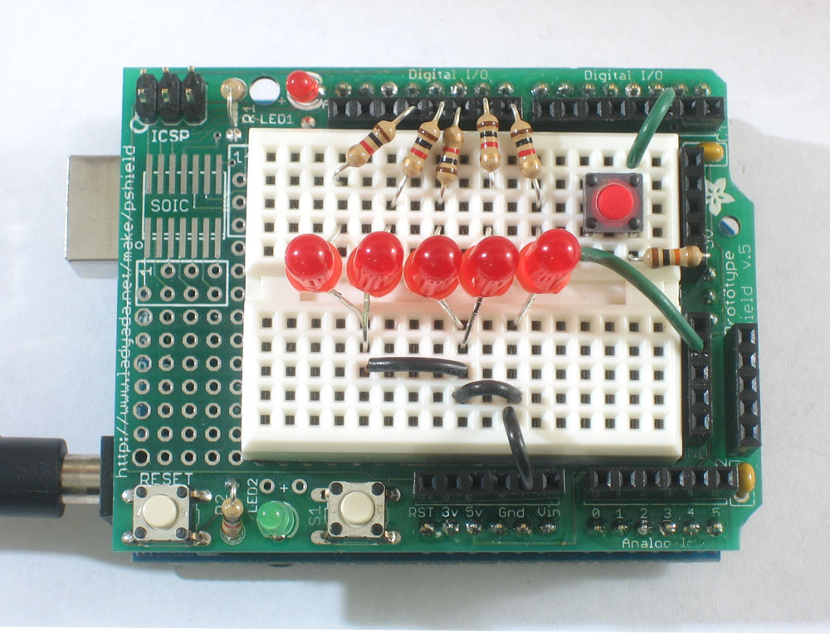
Using Arduino via MATLAB
Installed Arduin IO library to MATLAB.
I made this 4 mode LED where it goes off, on, blinking and wave pattern with a press of a button.

Slide 3
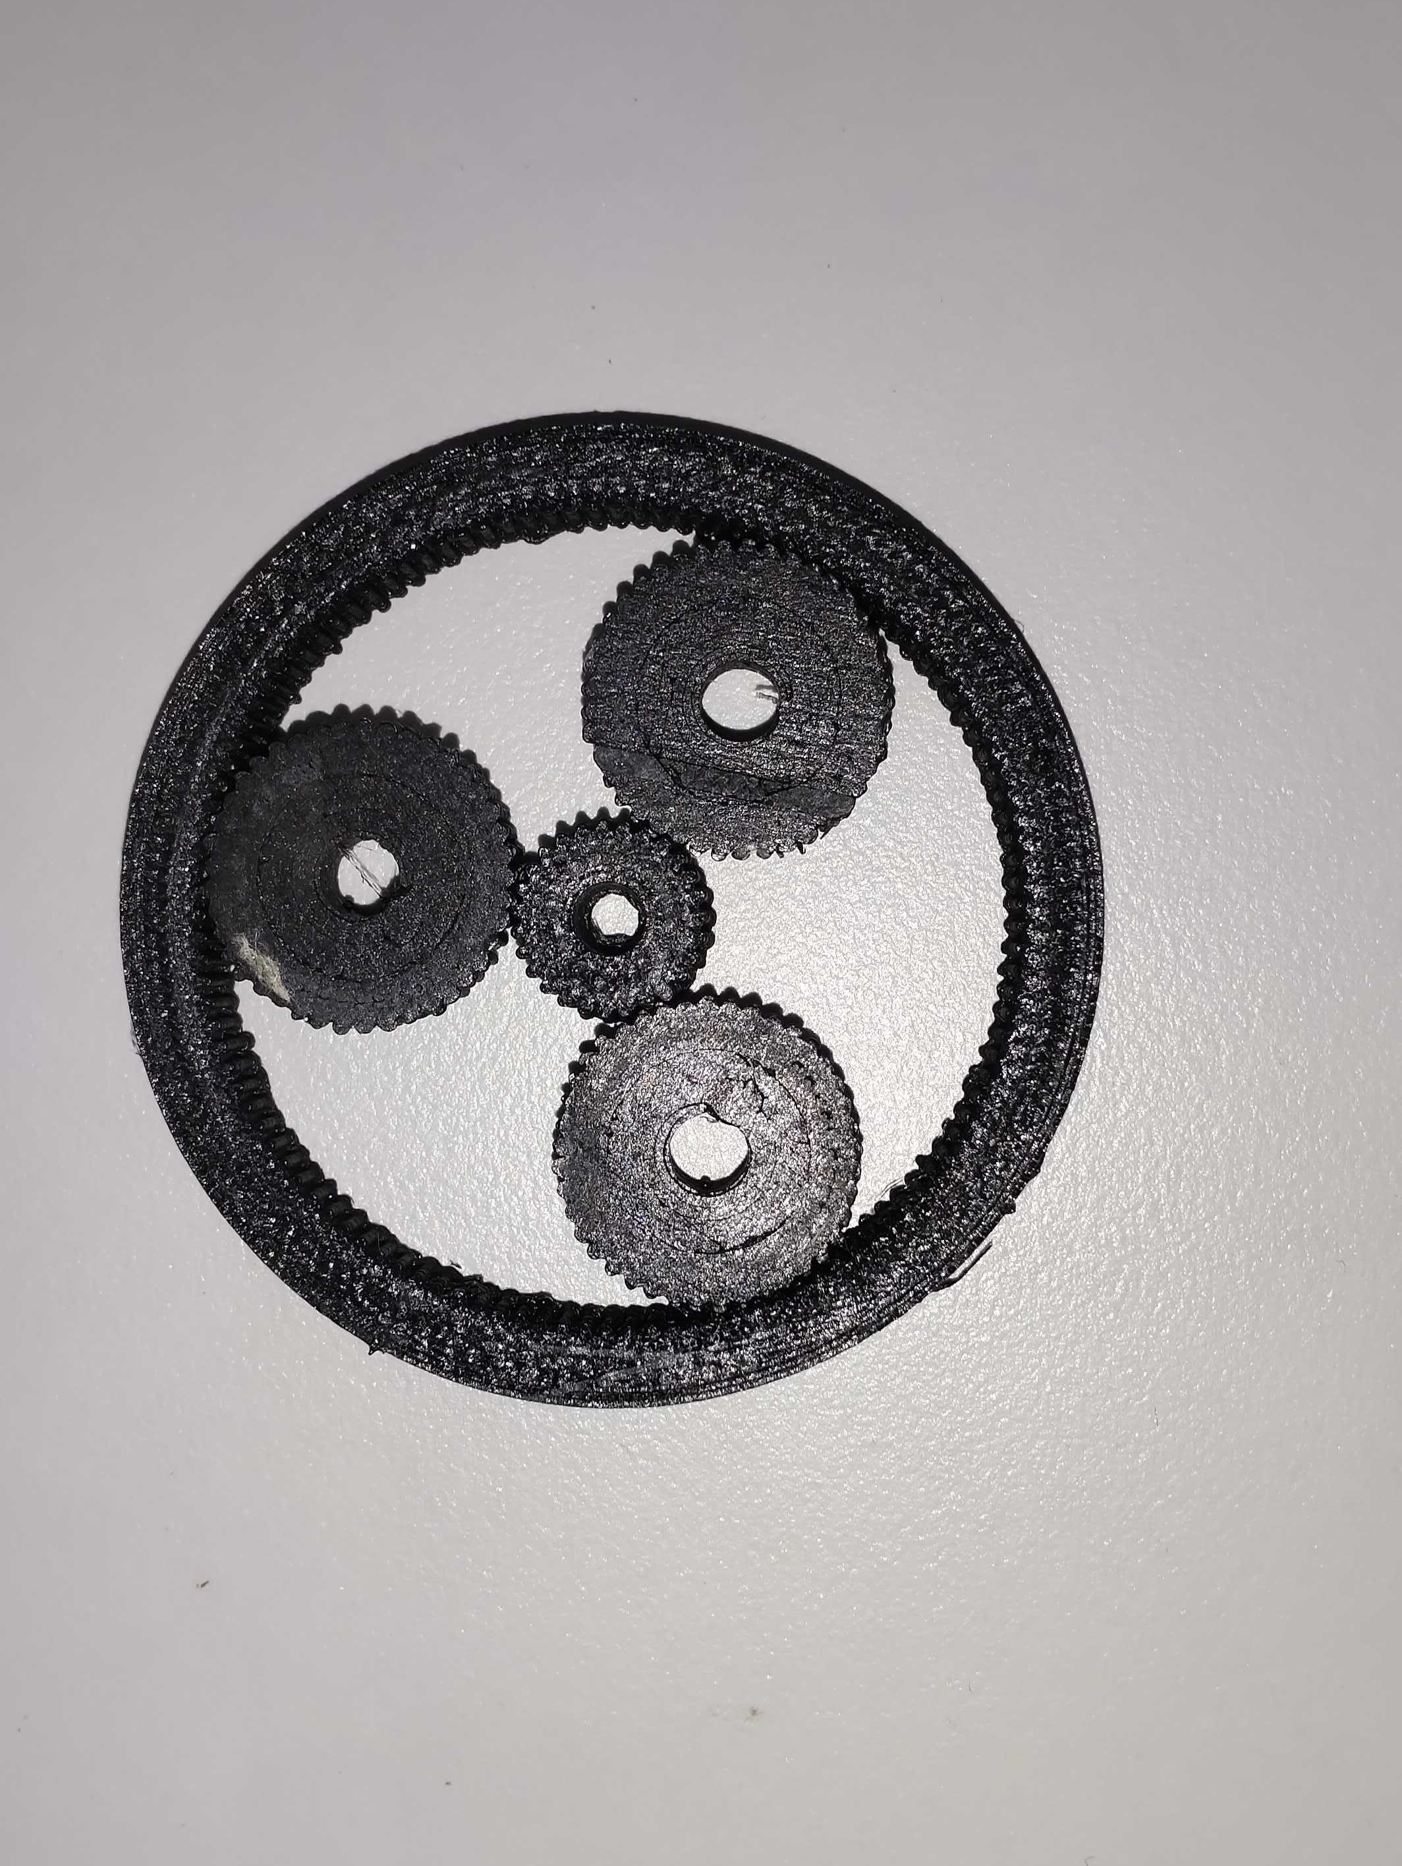
3D-Printing
3D-printed a planetary gearbox using FDM 3D-printer. Material used was carbon fiber.
Problem faced was that the model made in CAD was bigger and had to scale it down while 3D printing.
Now the diameter changed and module changed, due to this gears wouldn’t mesh properly.
But I learnt how to use a 3D-printer and the problems faced during printing it.

Slide 4
Inverted Pendulum Balancing Robot
I started working on it and I collected all the components except 2 components (Universal Plate Set and Motor driver IC).
I plan to complete it within next 2-3 days.

Slide 5
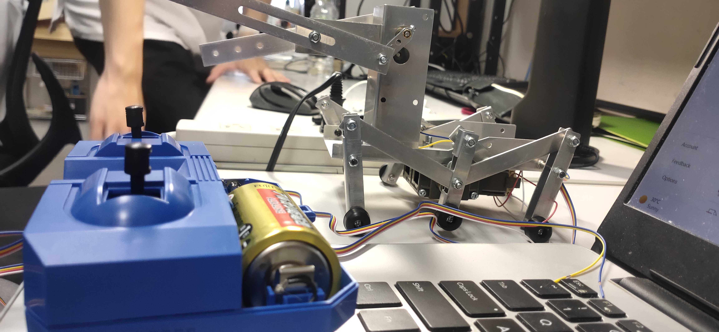
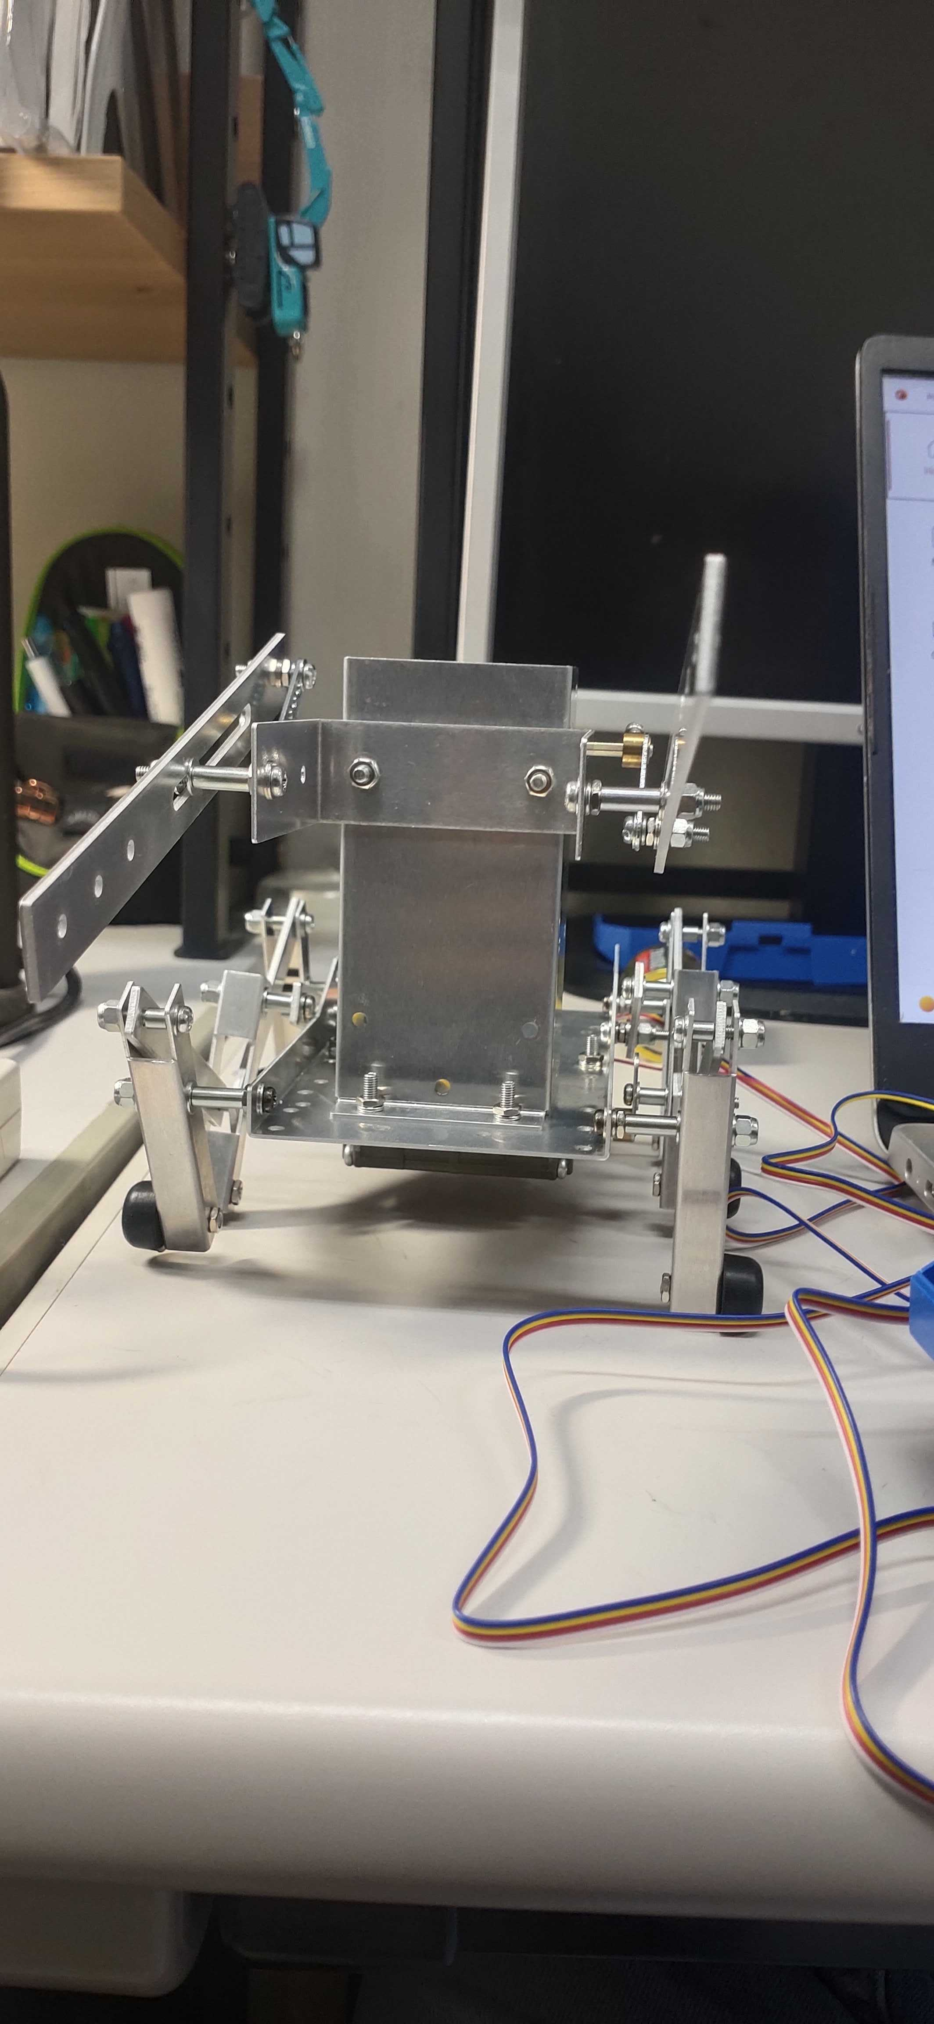
Boxer Robot
Made a boxer robot from the manual
Making few customization to the robot

Slide 6
Inverted Pendulum Balancing Robot
I am still working on it
Completed building electronics part of the system
Went to store and brought all hardware required for it
Target of completion is within 3 days

Slide 7
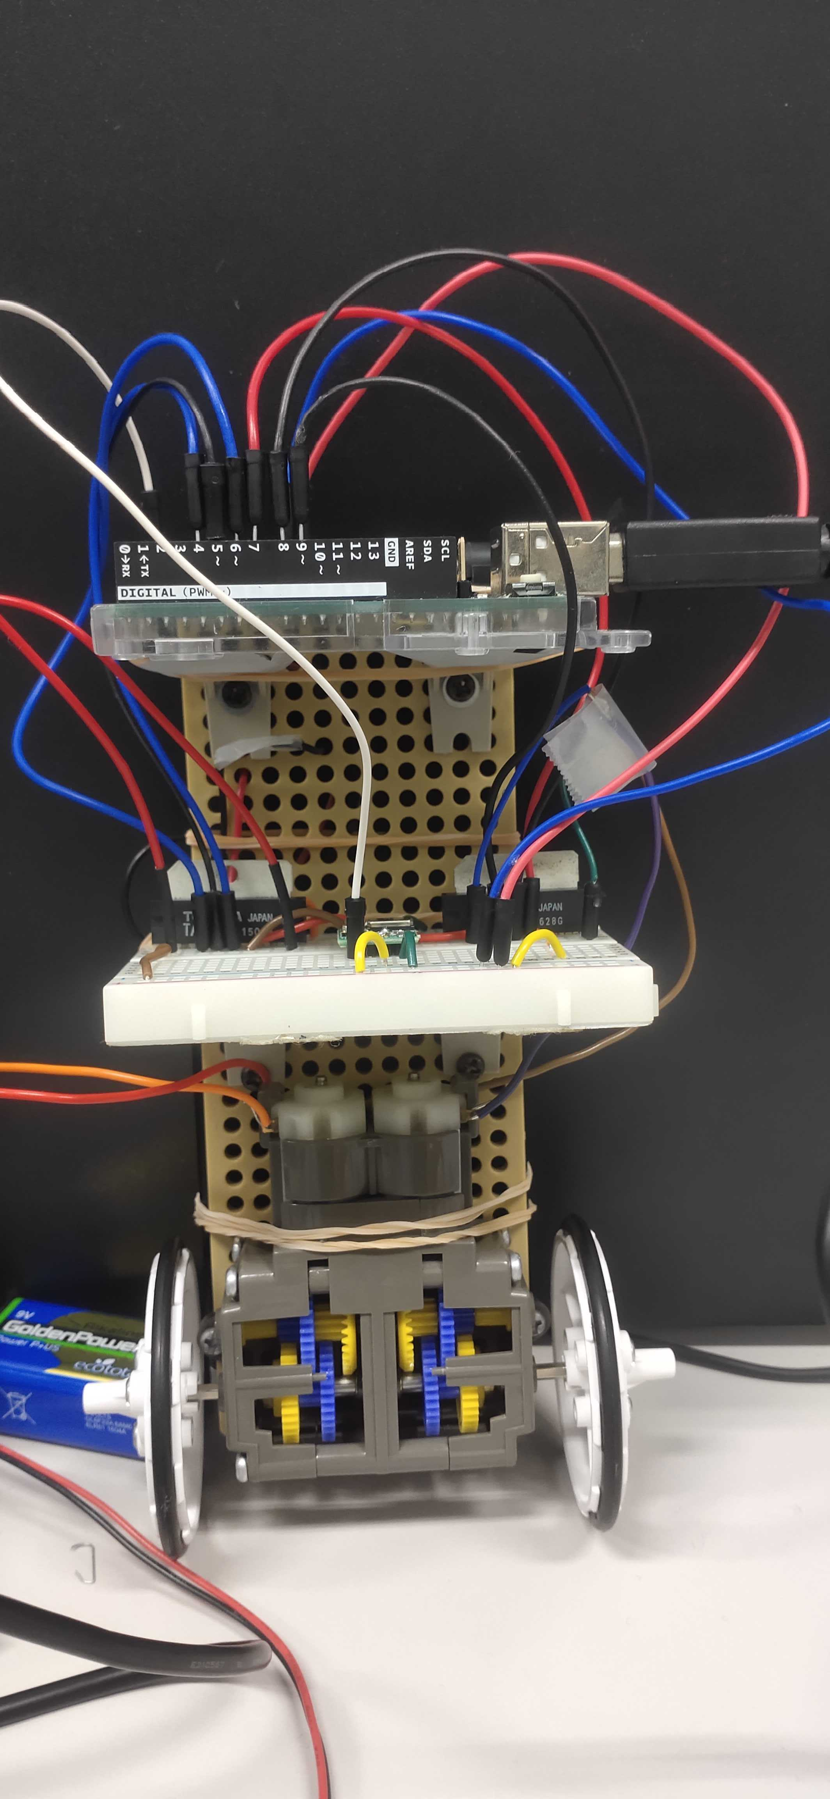
Inverted Pendulum Balancing Robot
I completed building the inverted pendulum robot
Power is being supplied to robot but is not able to balance itself
I am currently trying adjust the parameters such as angle, angular velocity of gyro and robot to balance itself.

Slide 8
Research Paper
I am planning to write a paper about 5 pages.
I am looking for the unique idea for the paper.
I currently thought of these keywords: CMG, robotic arm

